Slide 1
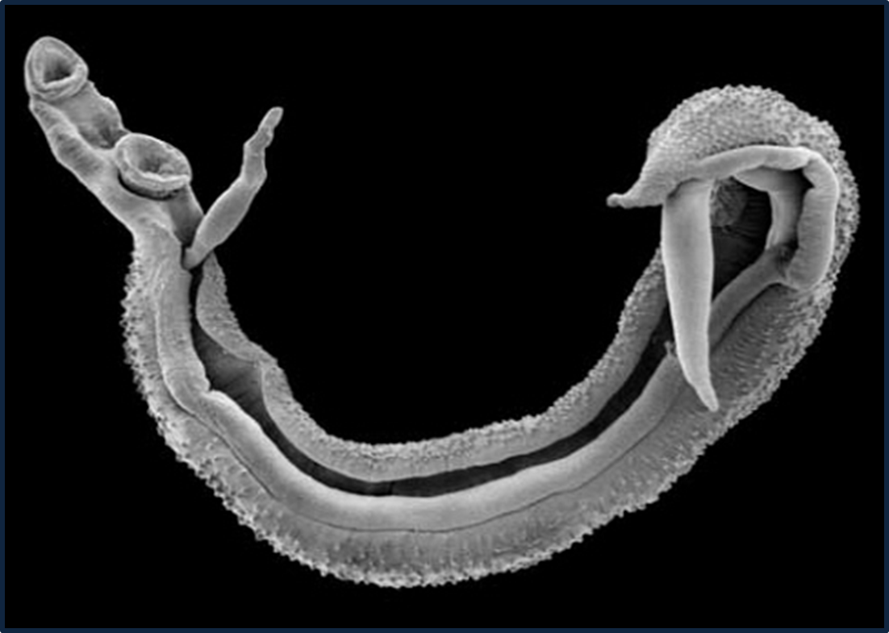
A Schistosomiasis Flipchart
Teaching Prevention, Control, and Treatment of Urogenital Schistosomiasis

Slide 2
A. What is urogenital schistosomiasis?
Questions you can ask:
What is schistosomiasis?
Schistosomiasis, also known as bilharzia, is an infection caused by a parasite.
A parasite is an organism that lives in or on another creature. The parasite that causes schistosomiasis is a blood fluke.
What is urogenital schistosomiasis?
Urogenital schistosomiasis is a kind of schistosomiasis. It can make you pee blood and can cause damage to the bladder. It can affect the ability of girls to have babies. The medical way of saying this is that it affects the urogenital system.
It affects children’s growth and makes them tired, and it can interfere with their ability to learn.
Who gets schistosomiasis?
Anyone can get schistosomiasis.
Schistosomiasis is most common in children, but adults can also get it.
How do you get schistosomiasis?
Schistosomiasis is carried by a special kind of small snail that lives in local streams, ponds, lakes, rivers, and rice fields.
You can get schistosomiasis when you go in ponds and streams that have infected snails.

Slide 3
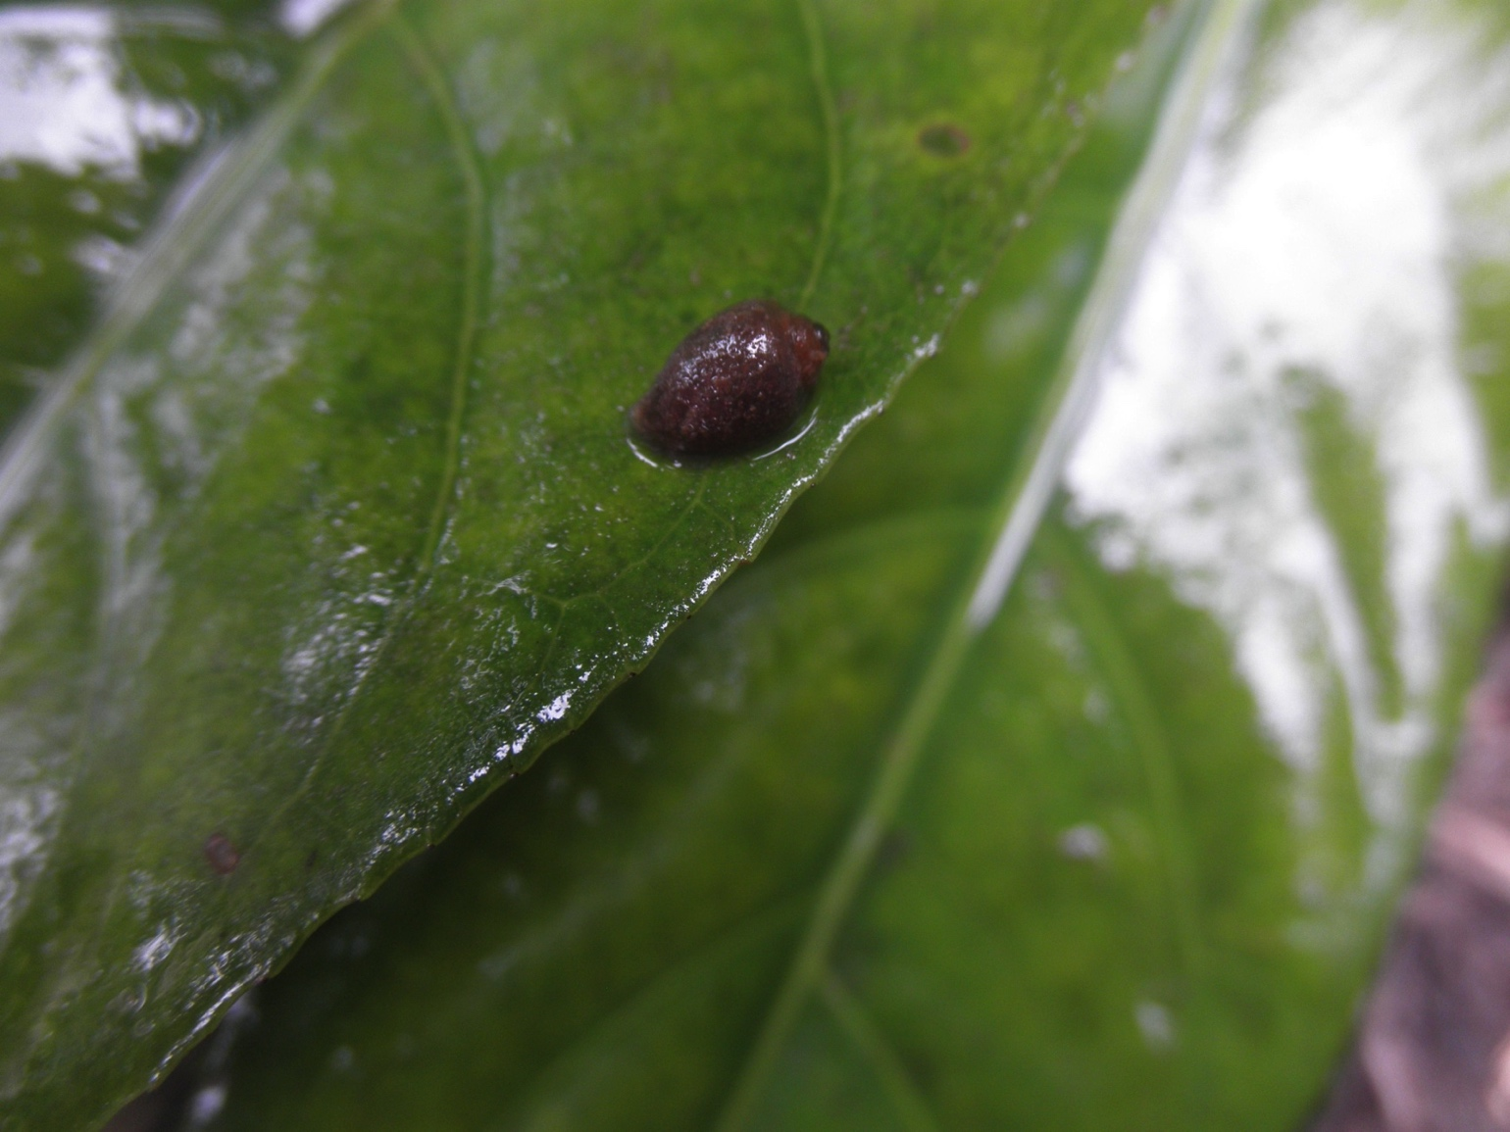
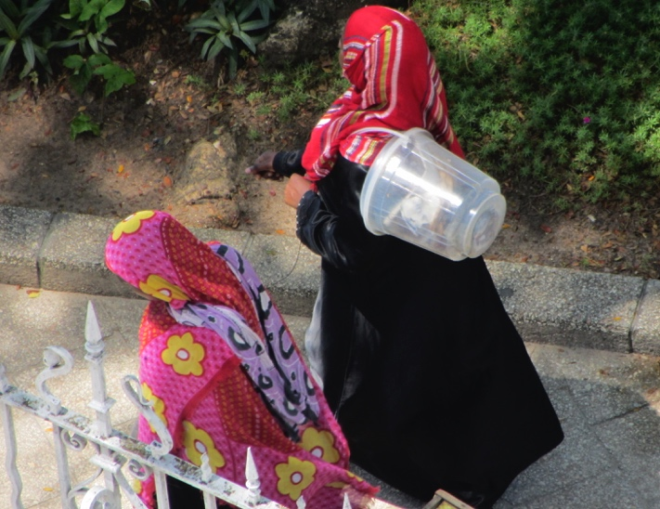
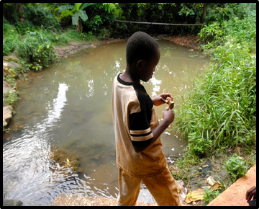
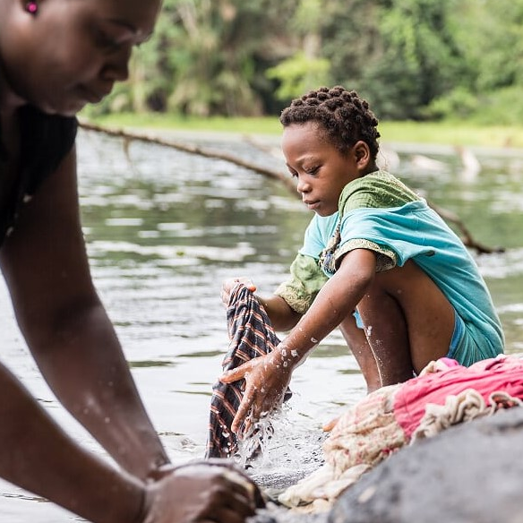
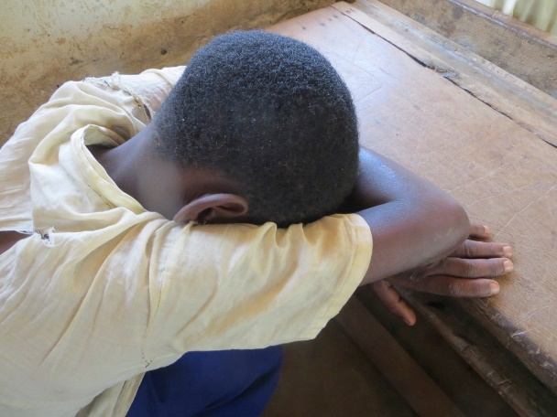
A. What is urogenital schistosomiasis?
Anyone can get
schistosomiasis!

Slide 4
B. The blood fluke
Questions you can ask:
How many people have ever had worms? What do they look like?
How many think that the schistosomiasis blood fluke is a worm?
You can see the blood fluke here, it is different from a worm.
What is the blood fluke?
The blood fluke is a nasty-looking creature that lives inside the body and makes people sick with schistosomiasis.
It is very small, but it can do a lot of damage.
Even if you are infected, you can’t see it in your pee or stool. It is not pooped out in feces like the common worm people have seen in their stools.
In the picture, the male fluke is on the outside, holding the female that lies inside. You can see the thin female sticking out of the male. You can see that this is not a common worm!
How does the blood fluke make people sick with schistosomiasis?
When the blood fluke is in someone’s body, it lays eggs.
Some eggs stay inside the body and cause bad things to happen there. Some eggs leave the body in pee.
If you are infected and you pee in a stream or pond, other people can get infected.

Slide 5
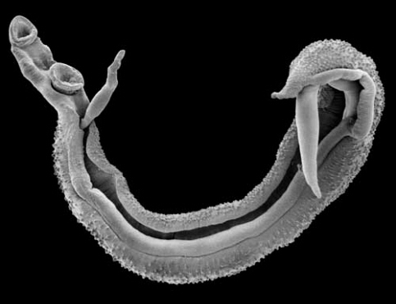
B. The blood fluke

Slide 6
C. The schistosomiasis snail
Questions you can ask:
Why do you need to go into water to get schistosomiasis?
Only a special type of snail can transmit schistosomiasis.
Schistosomiasis snails live in fresh water, like streams, ponds, lakes, rivers, and rice fields.
Every time a person steps in water where infected schistosomiasis snails live, they can get schistosomiasis.
How big are the snails that transmit schistosomiasis?
The snails are small -- about the size of a child’s fingernail.
If someone pees on the ground and you step in it will you get schistosomiasis?
No. If a person steps in someone’s pee on land they will not get schistosomiasis.
The schistosomiasis in a person’s pee does not infect people directly. It needs to live in a schistosomiasis snail for a while before it can infect another person.

Slide 7
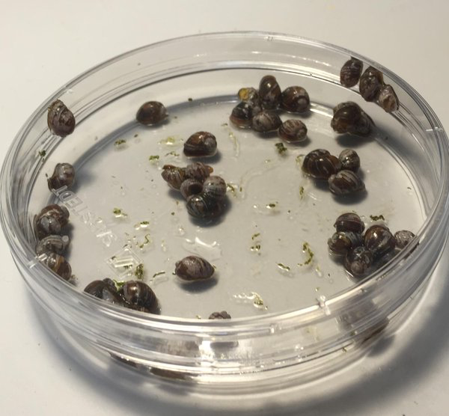
C. The schistosomiasis snail

Slide 8
D. Where does the schistosomiasis snail live?
The men in the picture are looking for schistosomiasis snails. Notice that they are not putting their bare legs and bare hands into the water.
Ask: How are they protecting themselves? [Waders to cover their legs, gloves to cover their hands.]
Questions you can ask:
Where are some streams or ponds around here where this snail might live?
      Do people play, swim, bathe, or wash their clothes in these ponds or streams?
      Have you ever gone in these streams and ponds?
      Now you know about the blood fluke and the schistosomiasis snail. What would you tell people about going in streams or ponds where these snails live?

Slide 9
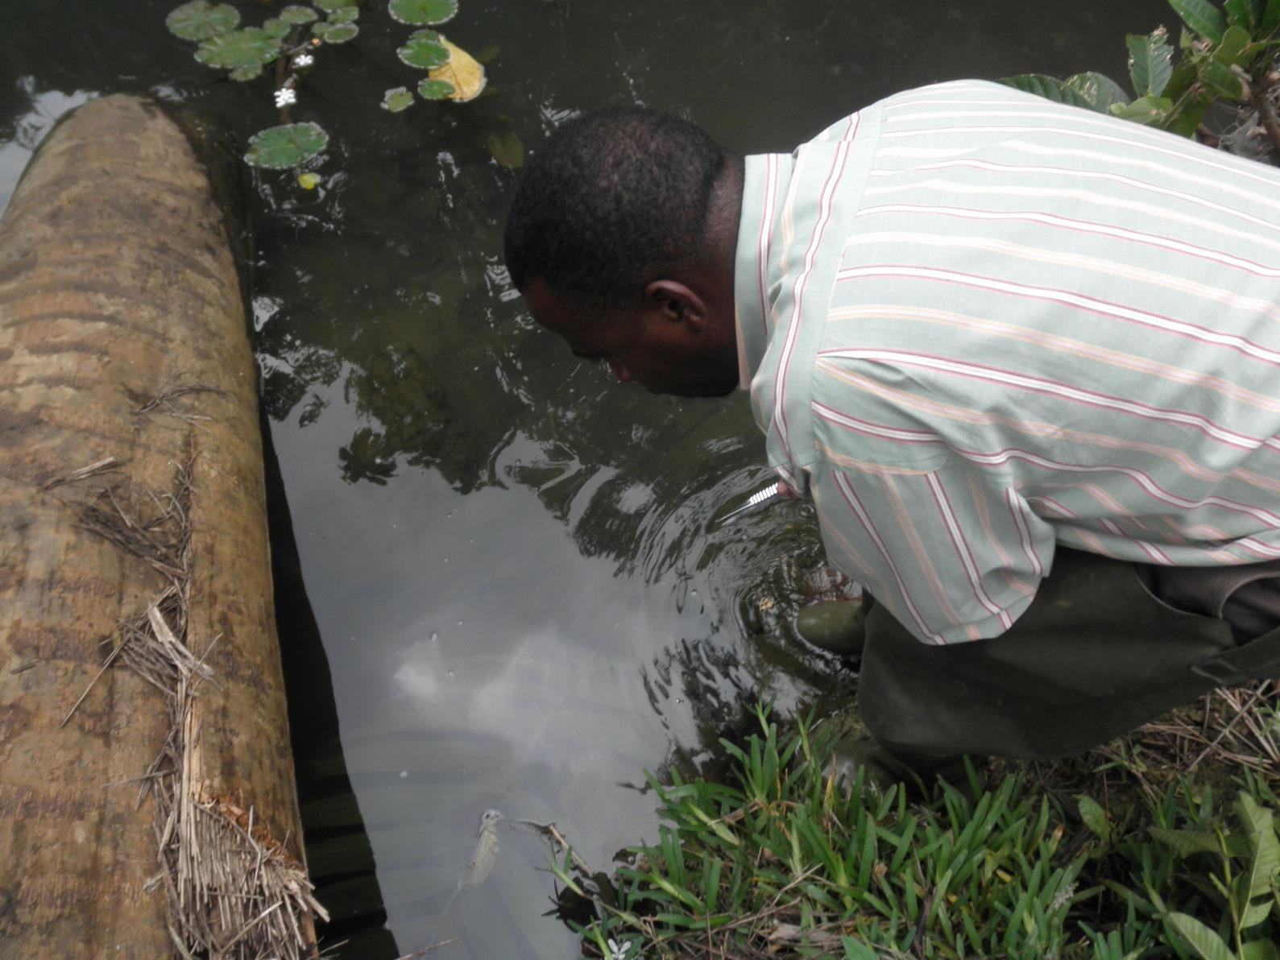
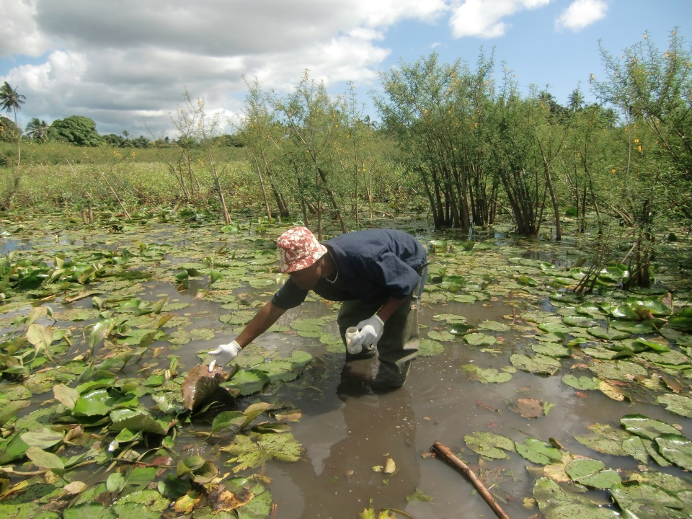
D. Where does the schistosomiasis snail live?

Slide 10
E. The blood fluke life cycle
Questions you can ask:
What creature needs to be in the water for a person to get schistosomiasis?
A schistosomiasis snail
How does schistosomiasis get in the snail?
People who are infected with schistosomiasis pee in the water
How does a person get schistosomiasis?
Going into water with infected snails
Here you see the blood fluke life cycle:
Adult blood flukes live in people and lay eggs.
When the infected person pees, they pee out eggs that get into the water.
Eggs hatch into miracidia – little swimming things that infect snails.
In snails, miracidia grow into cercariae.
The snails release the cercariae into freshwater.
When a person goes into the water, the cercariae go through their skin and travel to blood vessels.
Inside the blood vessels the cercariae turn into blood flukes.
The blood flukes lay eggs and damage the bladder. They cause other bad effects as well.
If this infected person pees in the water, the cycle starts all over again.

Slide 11
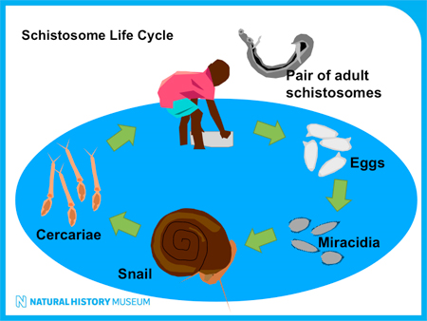
E. The blood fluke life cycle

Slide 12
F. Risk behaviors
Questions you can ask:
How do children spread schistosomiasis?
When children with schistosomiasis pee into water with schistosomiasis snails, they spread the disease. The schistosomiasis eggs in their pee infect the schistosomiasis snails. Then, any people who go in the water can catch schistosomiasis.
What are some activities people do that bring them into the water and puts them at risk?
Playing
Swimming
Washing clothes
Washing dishes
Bathing
Collecting water
Fishing
Taking care of animals
Working in rice fields
How do children get infected with schistosomiasis?
They go in a pond or stream or other water where snails infected with schistosomiasis live.

Slide 13
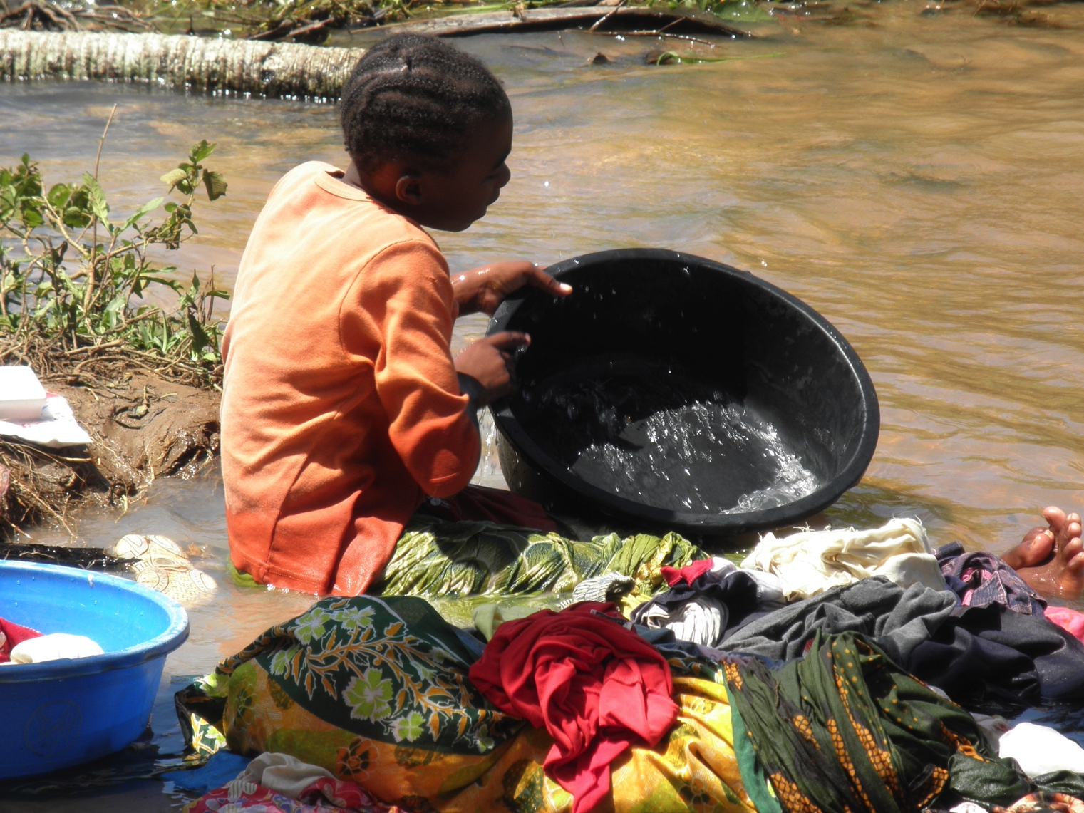
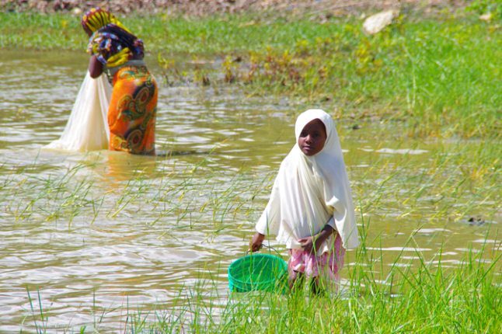
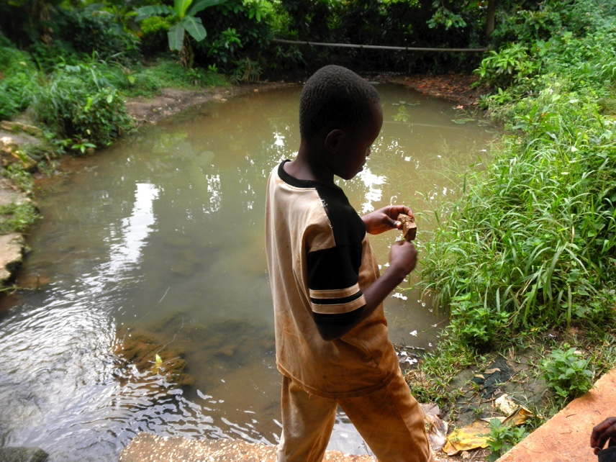
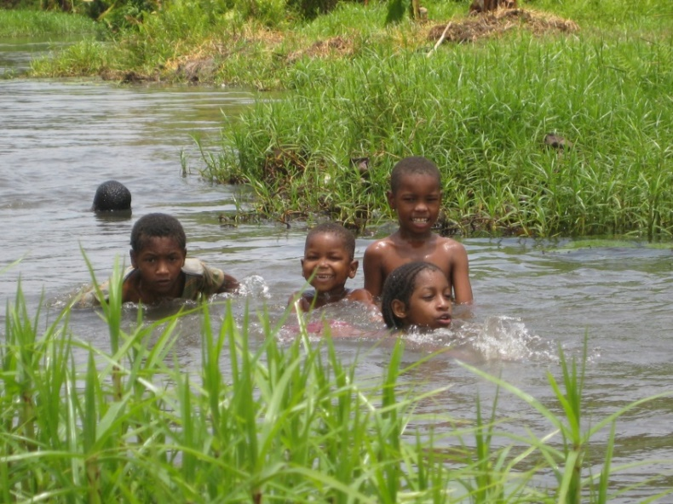
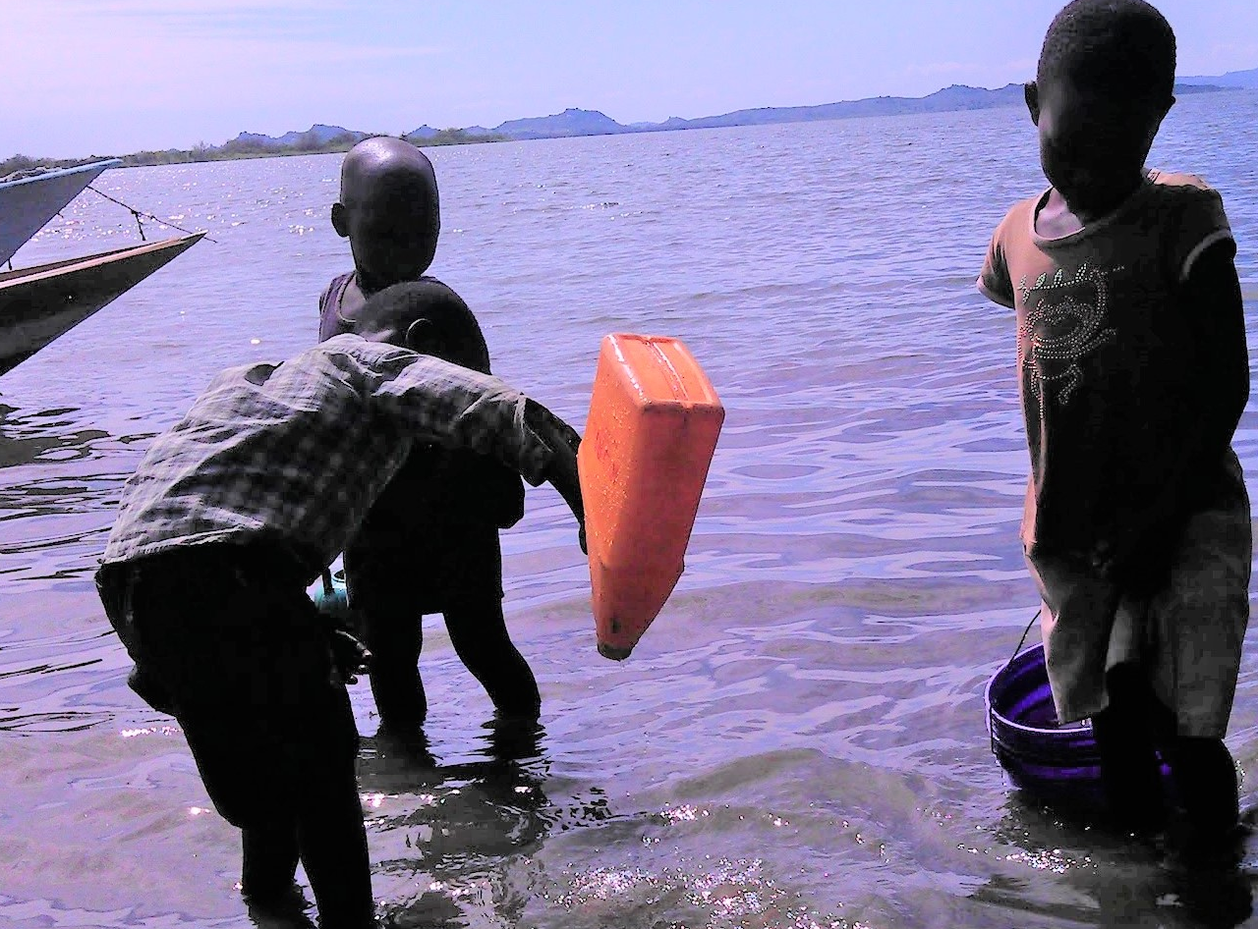
F. Risk behaviors

Slide 14
G. Symptoms of schistosomiasis
Questions you can ask:
What are the symptoms of schistosomiasis?
  Feeling like you have to pee and then you can’t pee
  Pain in the lower belly
  Severe pain when peeing
  Itching of the private parts
  Peeing blood
  Sometimes having fever
Other symptoms may be harder to recognize as being due to schistosomiasis.
These include:
  Feeling tired all the time
  Having less energy
  Having trouble paying attention in school
  Generally not feeling well
People can get very sick if they have schistosomiasis for a long time and don’t get treated.
  In some people it can cause bladder cancer
  It can make it harder for girls to have babies when they grow up
Does everyone with schistosomiasis show symptoms?
  No. Some people can have schistosomiasis with no symptoms

Slide 15

G. Symptoms of schistosomiasis

Slide 16
H. Testing for schistosomiasis
It is easy to find out if you have schistosomiasis:
First, you pee in a cup.
A health worker checks for blood or schistosomiasis eggs in the pee.
Sometimes there is so much blood in pee you can see it just by looking. Here you see pee that has blood in it (red) and pee that is clear and healthy (yellow).
Other times, there is only a little bit of blood, so you can’t tell just be looking at the pee. But the health worker can test for it.
The eggs can only be seen under a microscope. Here is a laboratory worker looking for the schistosomiasis eggs in a person’s pee.
Doing these tests allows us to diagnose schistosomiasis.
If you have symptoms, you should be tested. If the test shows you have schistosomiasis, you should get treated to make you better.

Slide 17
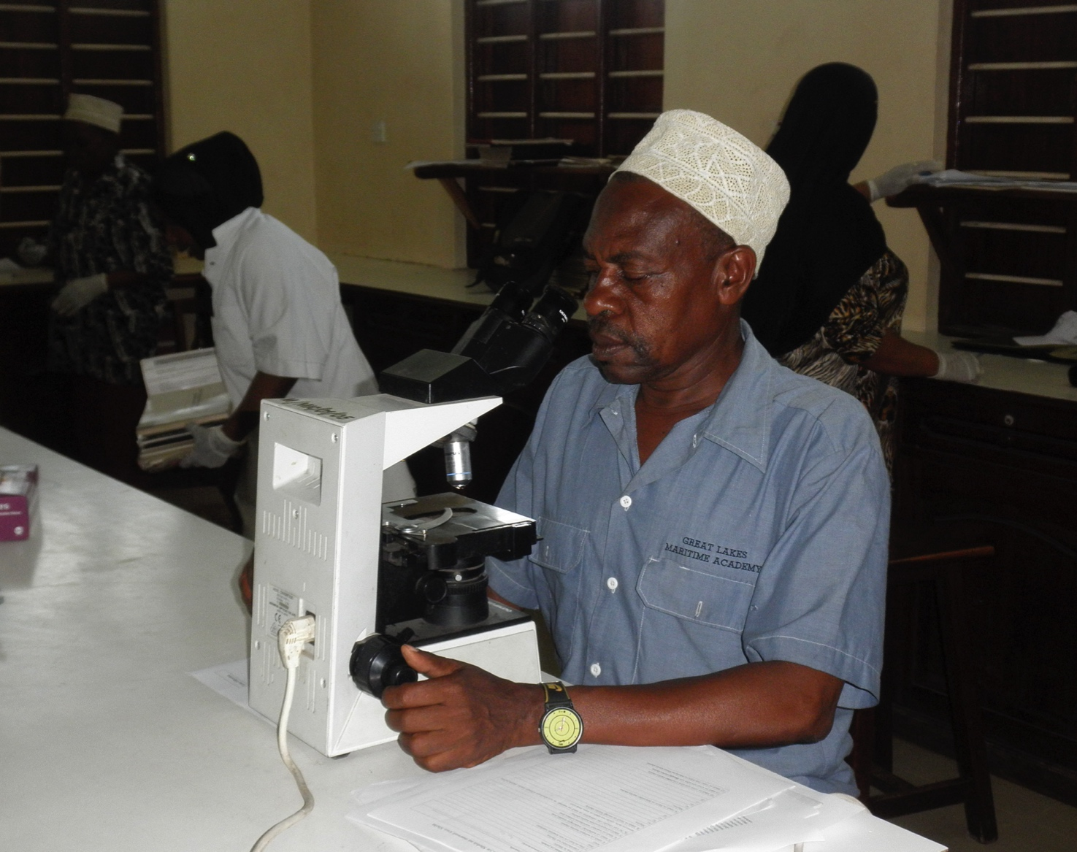
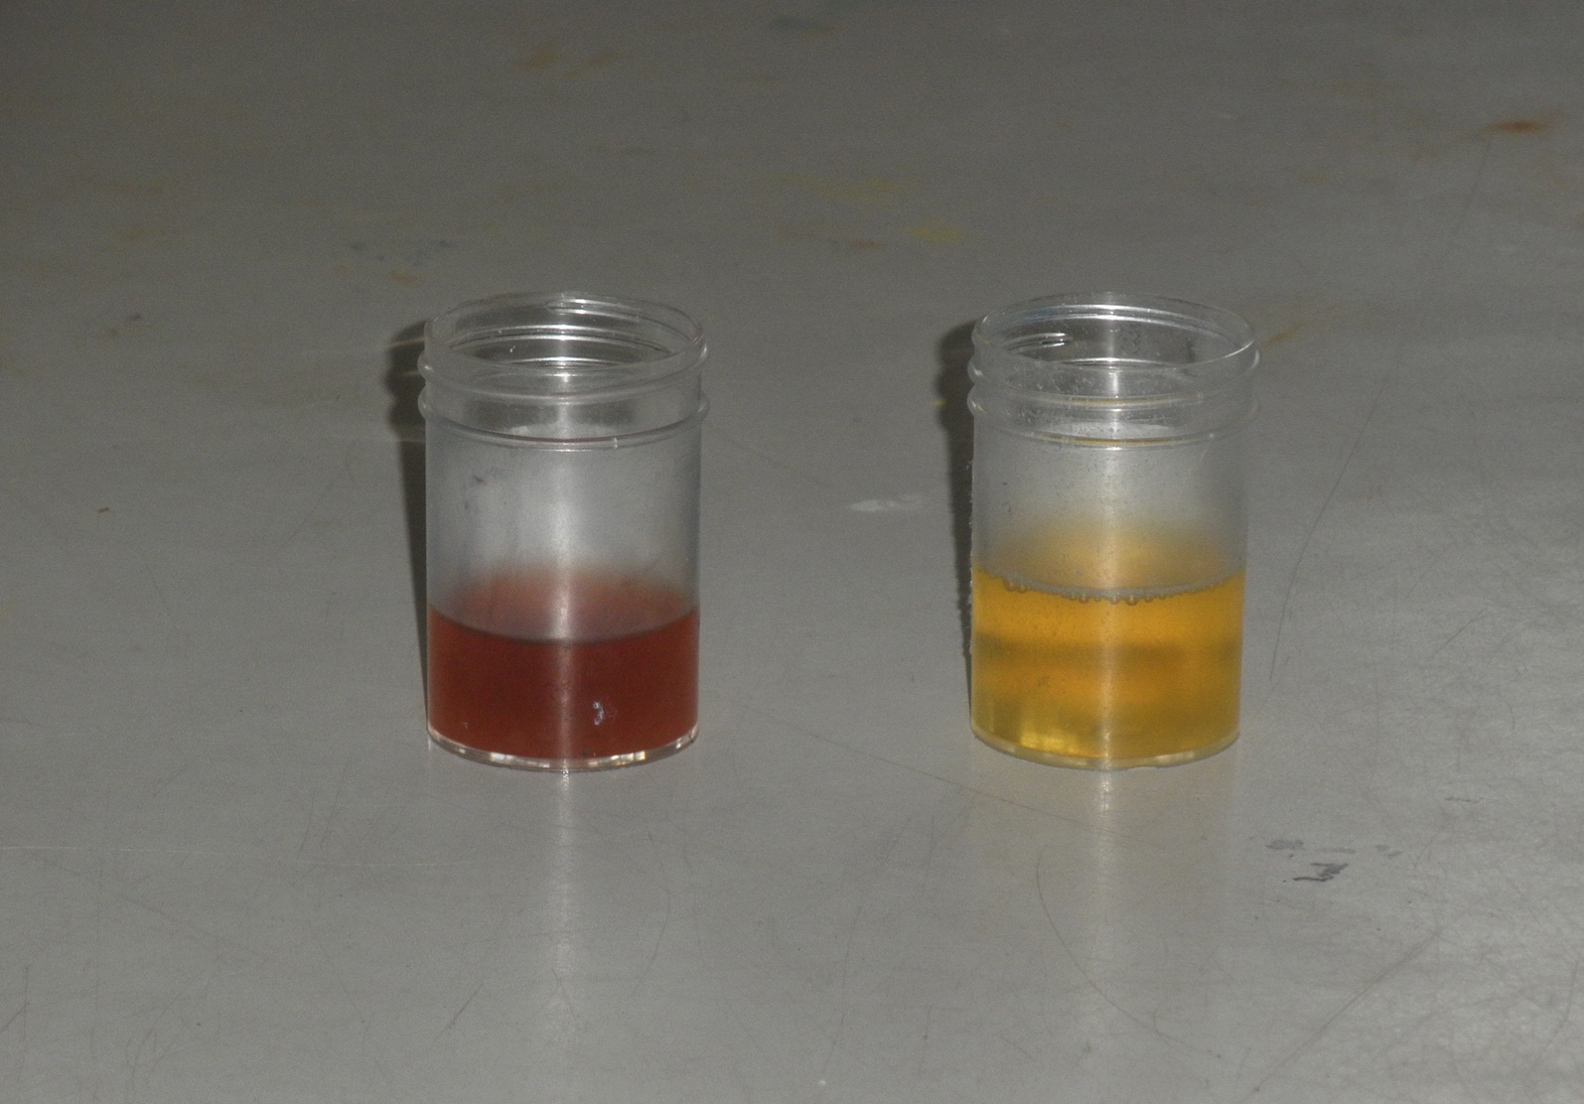
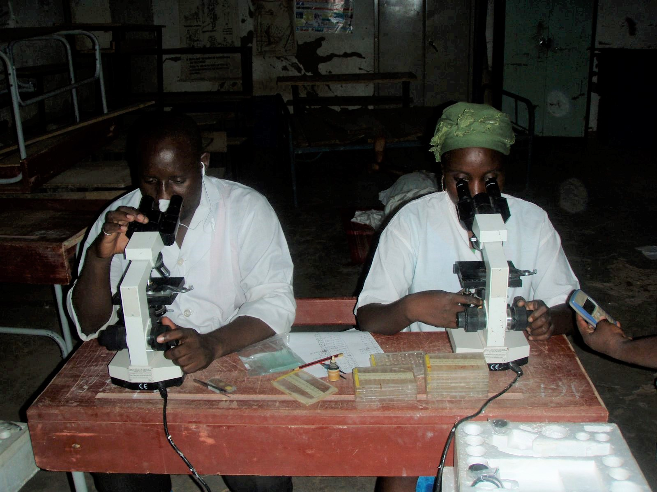
H. Testing for schistosomiasis

Slide 18
I. Treating schistosomiasis
Here you see a mother seeking treatment for her young son with schistosomiasis.
The best medicine for treating schistosomiasis is praziquantel.
You need strong medicine like praziquantel to kill the nasty blood flukes.
The number of praziquantel pills to take depends on your weight or height. The child is being measured to see how much praziquantel she needs.
Sometimes all the children in the school or all the people in the community are treated at the same time to get rid of as much schistosomiasis as possible.
You need to swallow all the tablets together to kill the blood flukes.

Slide 19
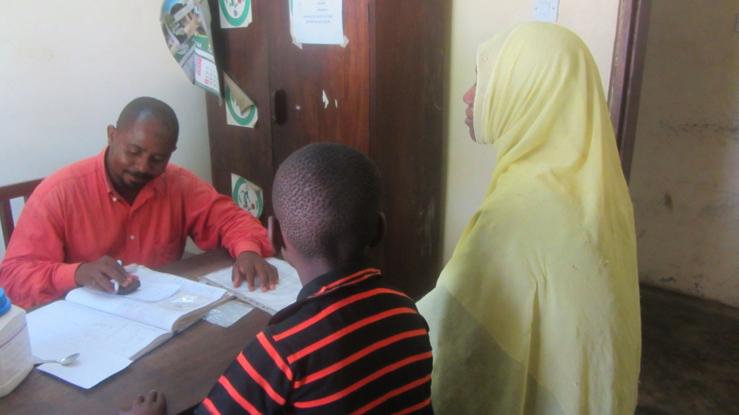
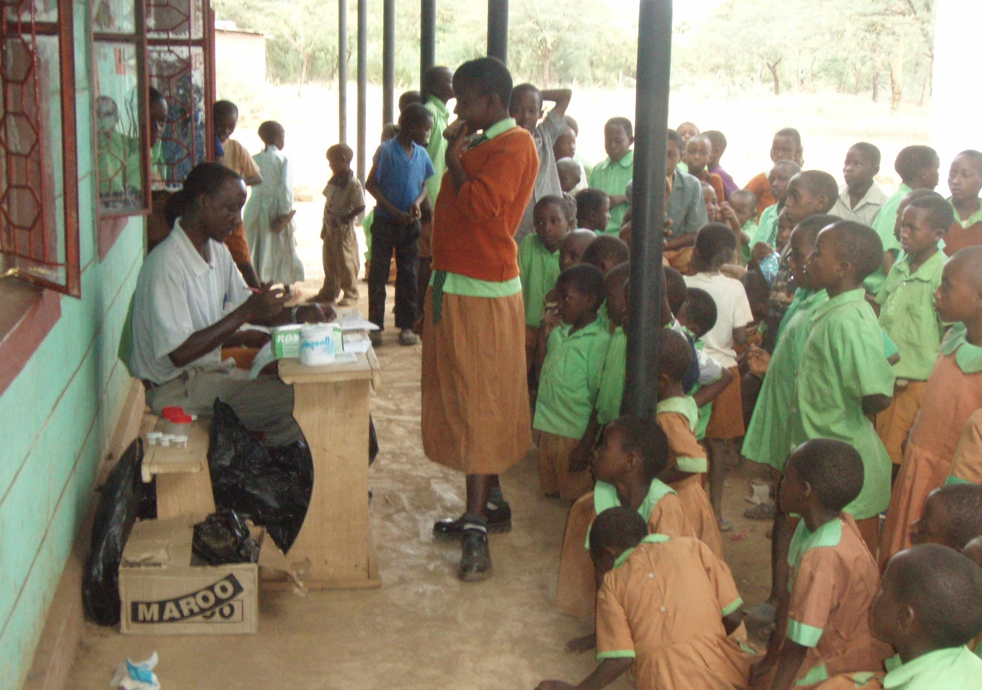
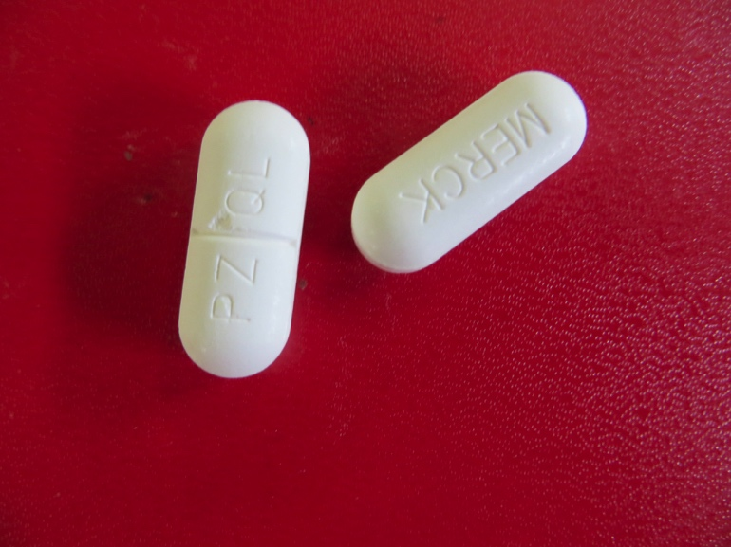
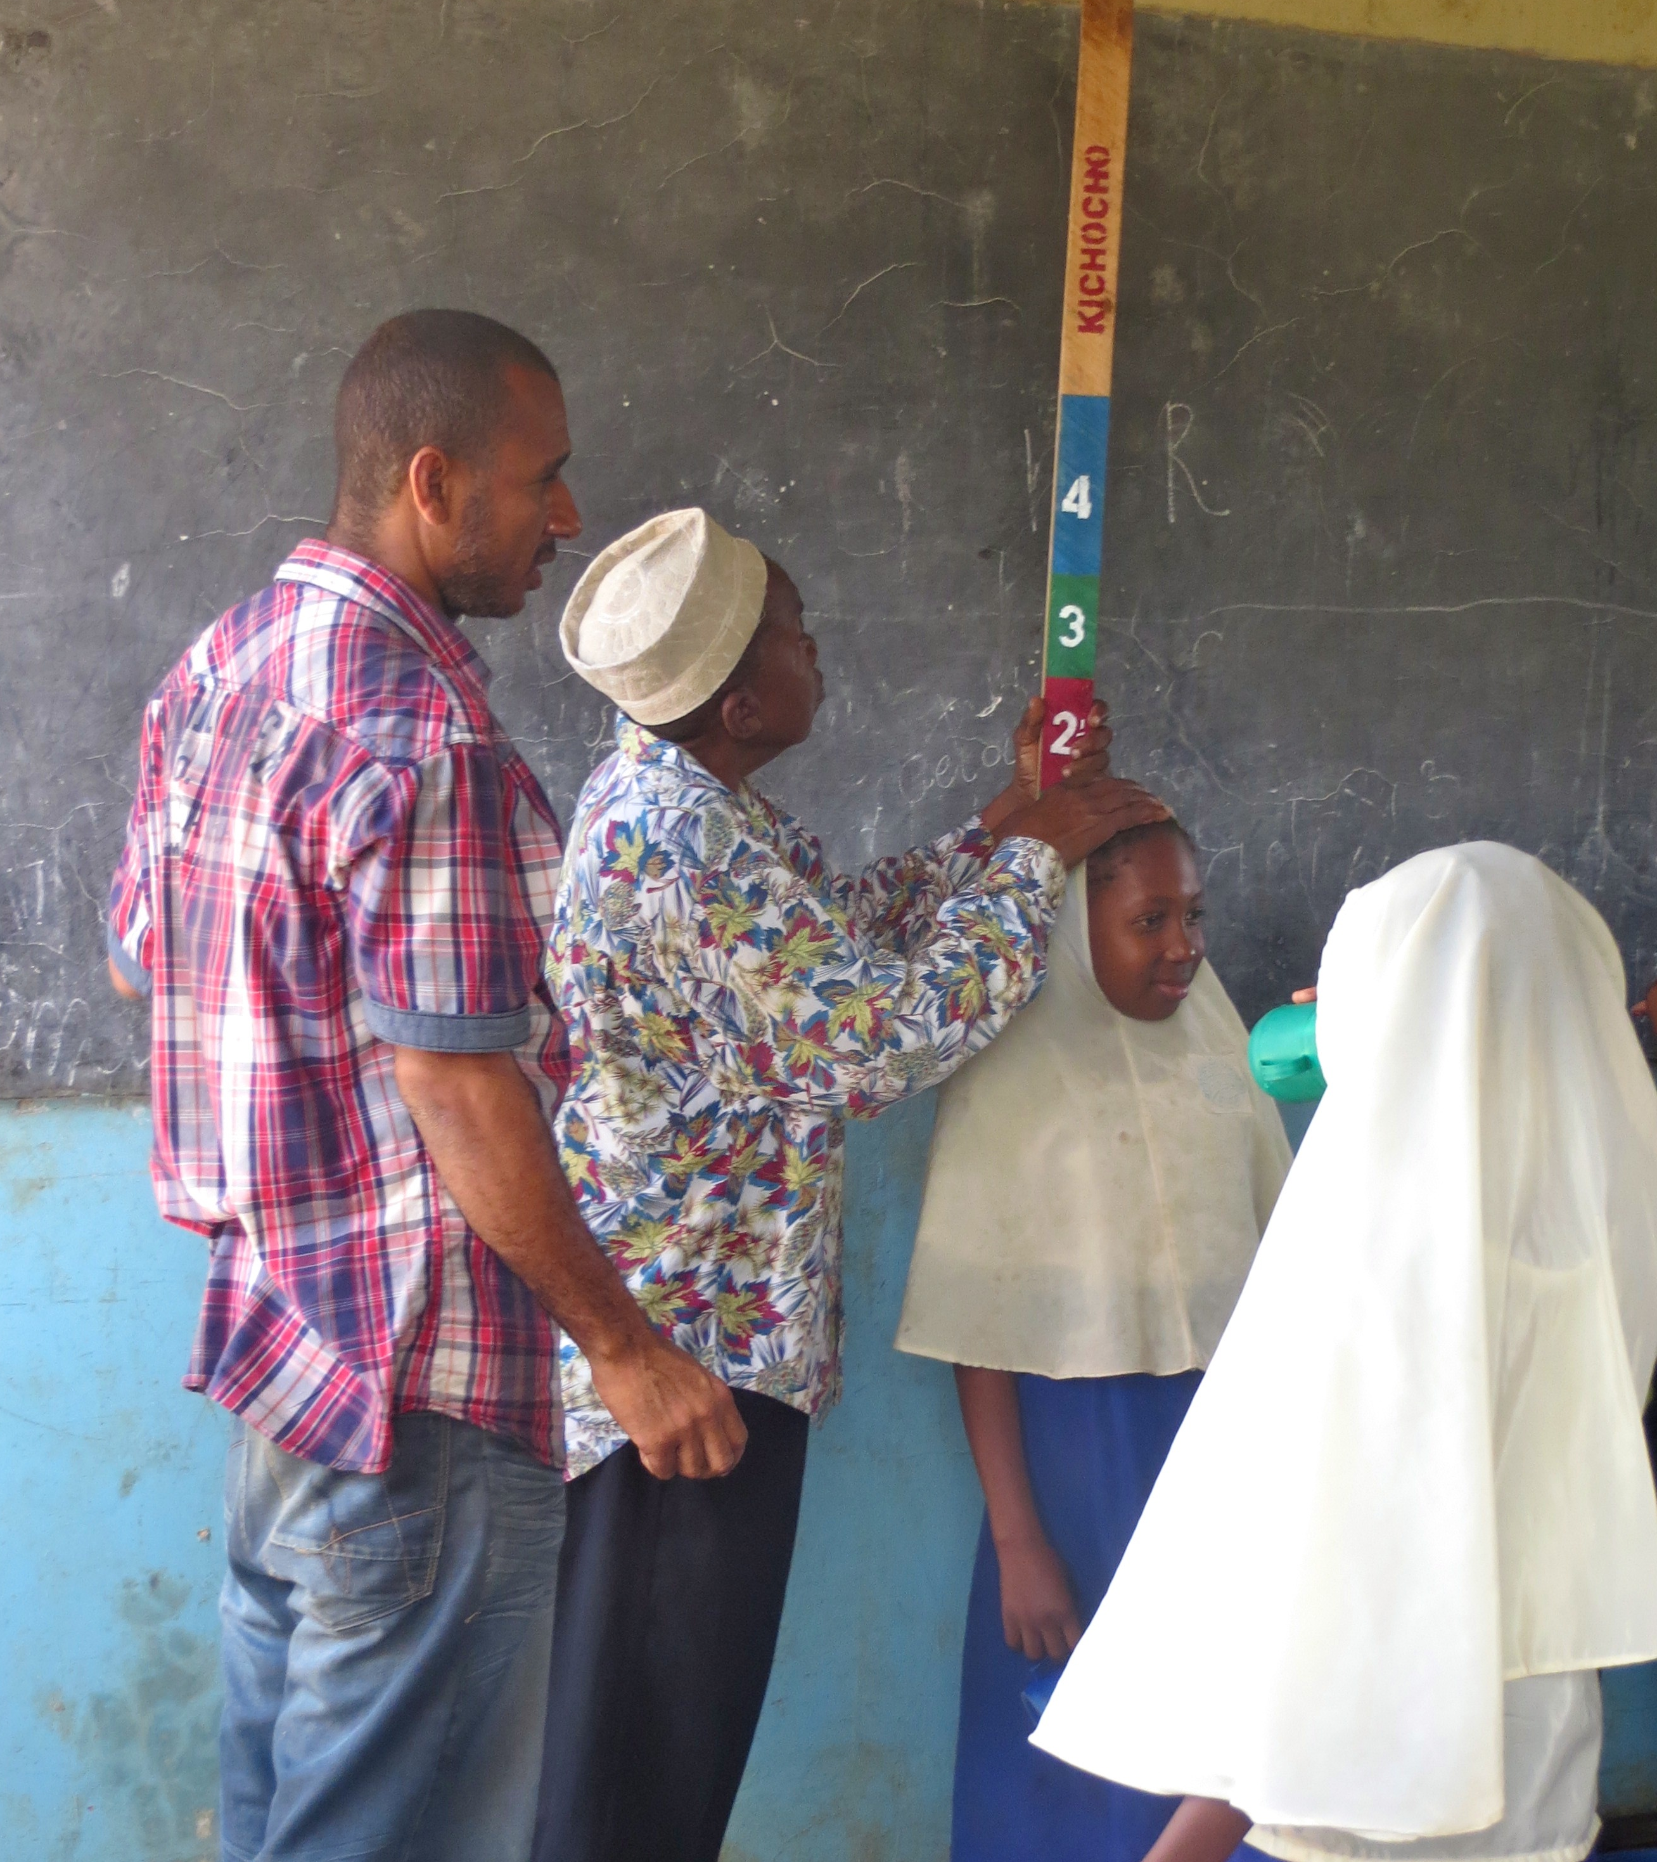
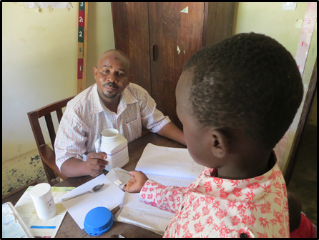
I. Treating schistosomiasis

Slide 20
J. Preventing schistosomiasis
Questions you can ask:
How can you keep from infecting other people if you have schistosomiasis?
Do not pee in a pond or stream. Pee in a urinal, latrine, or toilet
What are some ways you can avoid getting schistosomiasis?
Possible answers include:
Do not bathe in a pond or stream
    Use tap or well water to bathe
    Do not wash clothes or dishes in a pond or stream
    Use tap or well water to wash clothes or dishes
Do not fish or play in a pond or stream
    Play games like football or other fun activities on land

Slide 21
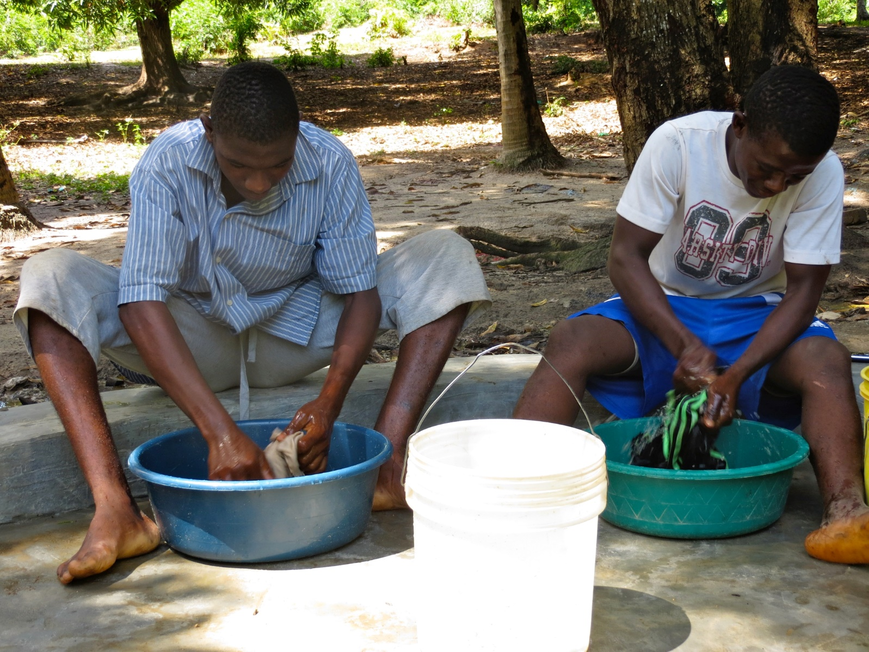
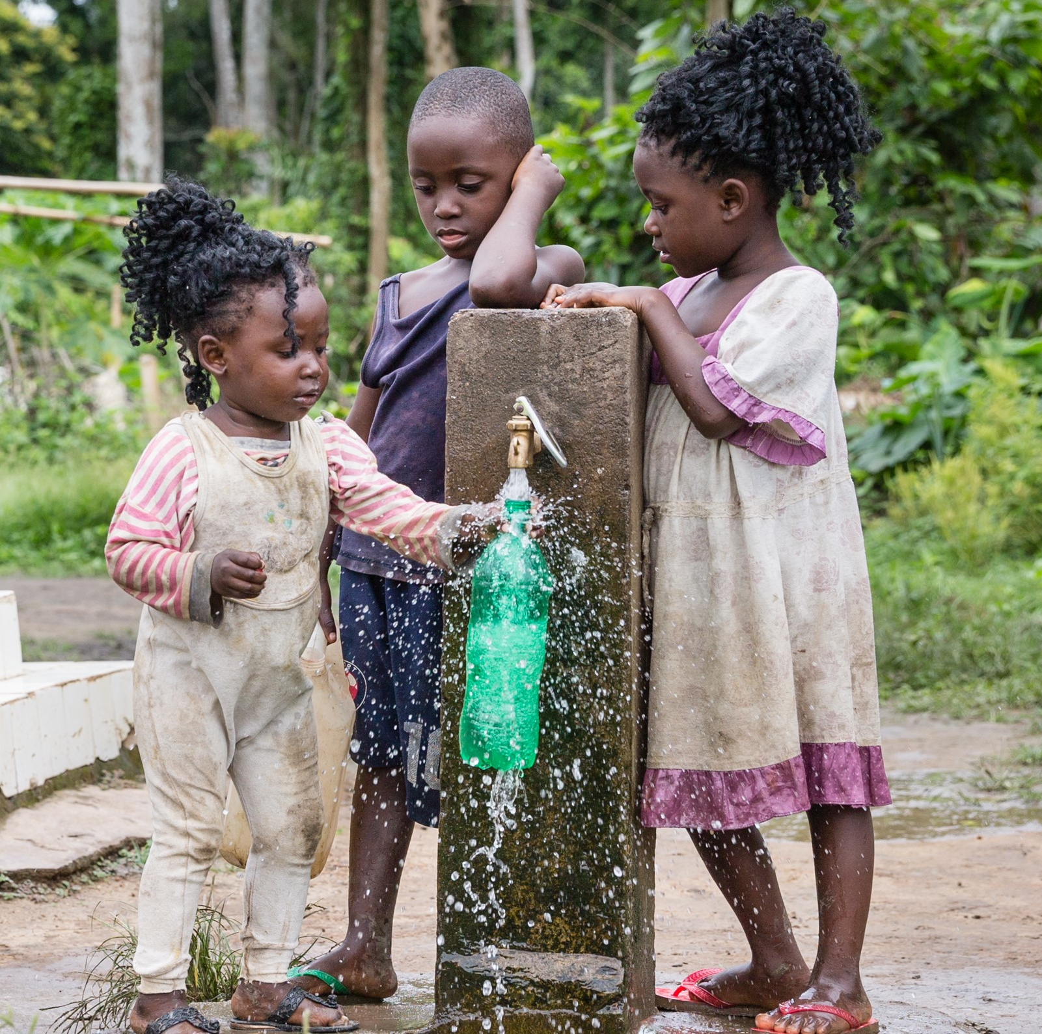
J. Preventing schistosomiasis

Slide 22
K. Safe games and activities for boys
Here are boys playing games and activities that keep them safe from schistosomiasis. These games are not in the water.
Questions you can ask:
Have you ever played these games?
What games do you like to play?
What are other games and activities boys can play that will keep them safe from schistosomiasis?

Slide 23
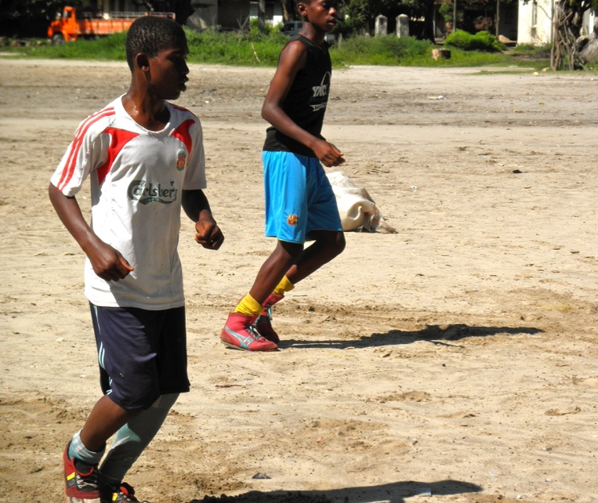
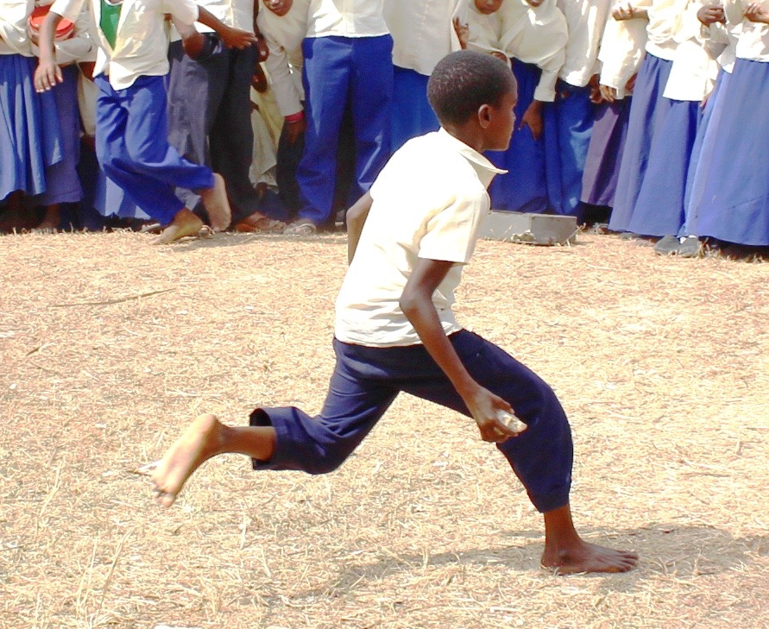
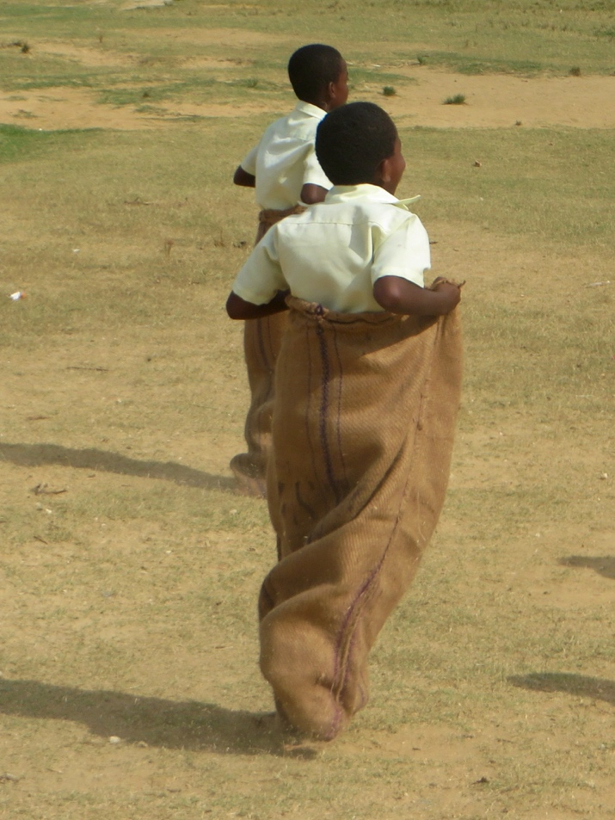
K. Safe games and activities for boys

Slide 24
L. Safe games and activities for girls
Here are girls playing games and activities that keep them safe from schistosomiasis. These games are not in the water.
Questions you can ask:
Have you ever played these games?
What games do you like to play?
What are other games and activities girls can play that will keep them safe from schistosomiasis?

Slide 25
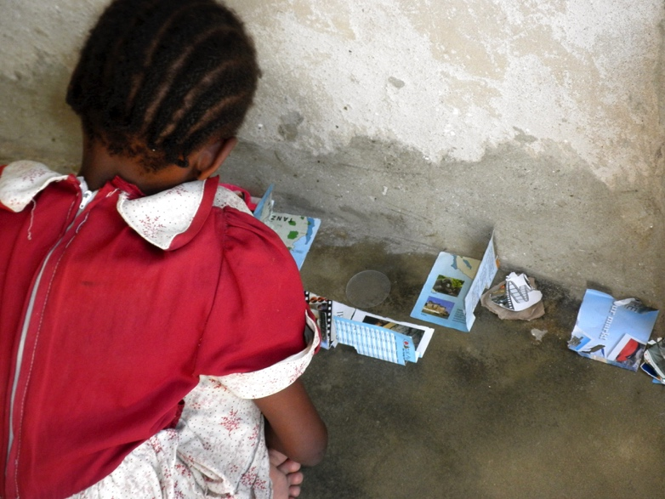
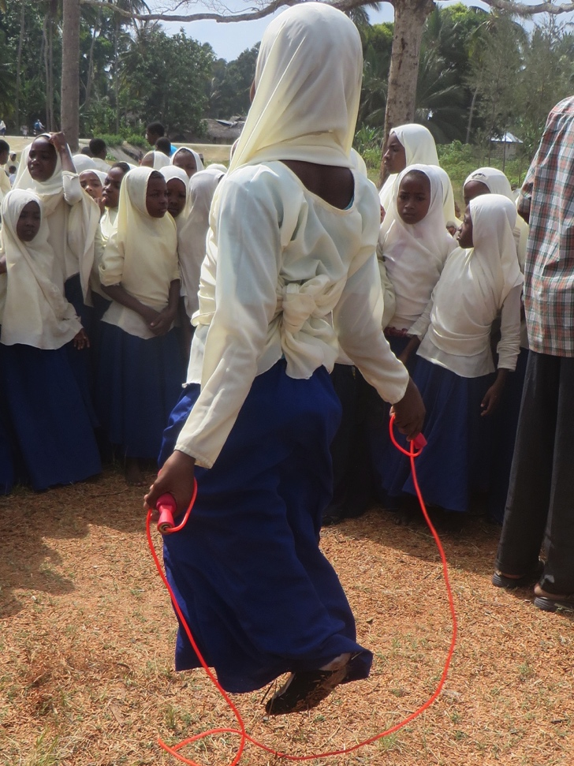
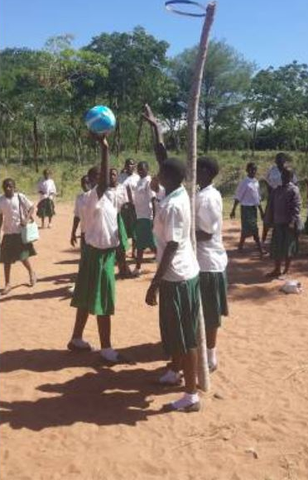
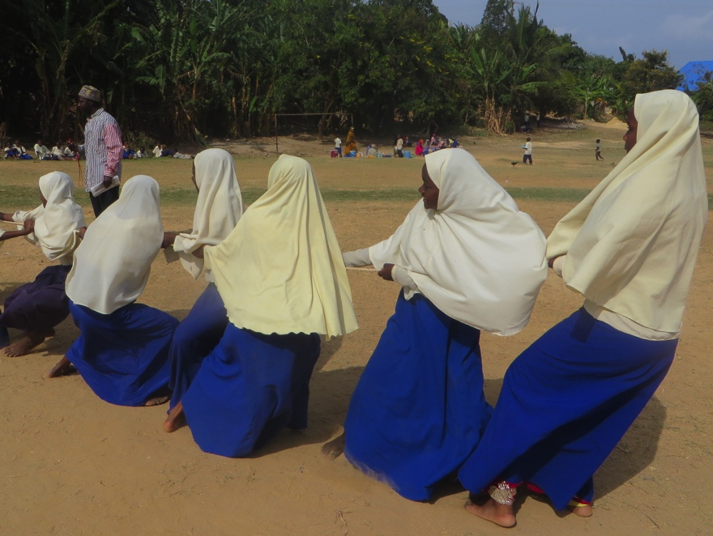
L. Safe games and activities for girls

Slide 26
M. Keeping safe from schistosomiasis
Questions you can ask:
You see a friend playing in the stream. What could you tell them about schistosomiasis?
You now have learned a great deal about schistosomiasis. What could you tell a friend about the blood fluke?
What could you teach a friend about the schistosomiasis snail?
You can also ask students to do role-plays to show how they would teach a friend about schistosomiasis.

Slide 27
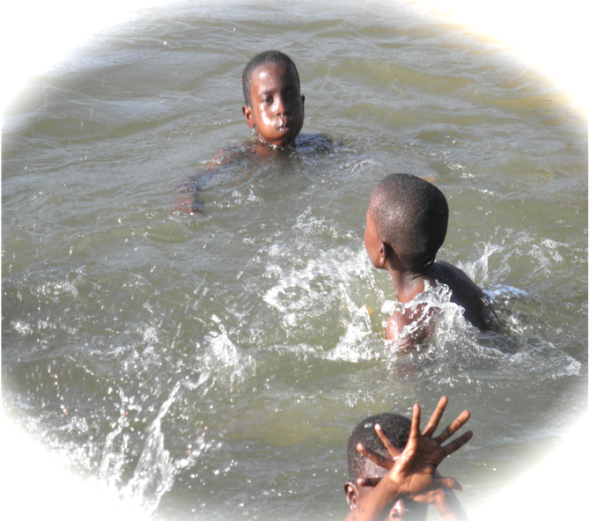

M. Keeping safe from schistosomiasis

Slide 28
N. Community interventions
Community members can work together to help students and people in the community change behaviours.
The picture on the left shows a community urinal. We do not want people to pee in streams and ponds. By providing urinals, a community can help change the behavior of children, and of all the people in the community.
The picture on the right shows a laundry washing platform. People can sit on the edge of the platform and wash their clothes instead of washing them in the stream. This keeps them from getting infected with schistosomiasis.

Slide 29
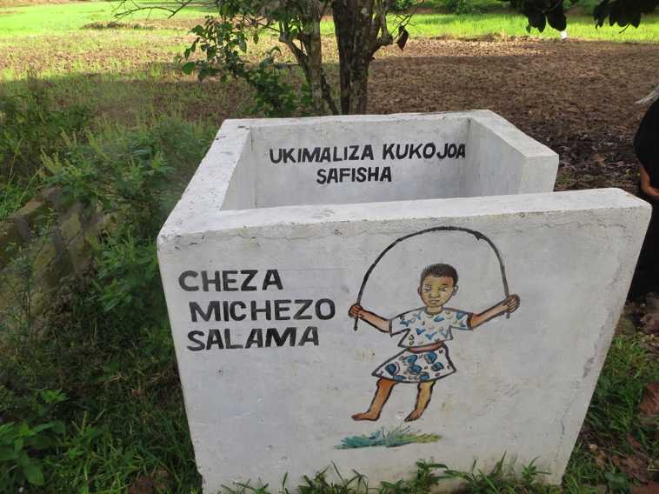
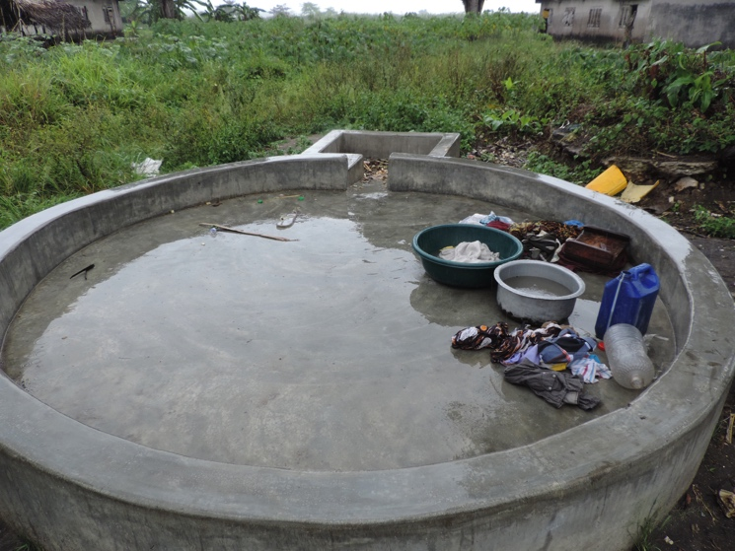
N. Community interventions
Community
Urinals
Community Laundry Platforms
Peeing in urinals instead of peeing in streams or ponds to prevent transmission of schistosomiasis.
Washing clothes on laundry platforms instead of washing in infected streams or ponds.

Slide 30
O. Evaluation questions
  What is schistosomiasis?
  How do children get schistosomiasis?
  How can children avoid getting schistosomiasis?
  What are the symptoms of schistosomiasis?
  How is schistosomiasis diagnosed?
  How is schistosomiasis treated?
  Please tell me about the schistosomiasis blood fluke.
  Please tell me about the schistosome life cycle.

Slide 31
O. Evaluation questions

Slide 32
Which Flipchart Section goes with which Lesson Plan?
A. What Is Urogenital Schistosomiasis? is linked to Lesson 1
B. The Blood Fluke is linked to Lesson 2
C. The Schistosomiasis Snail is linked to Lesson 3
D. Where Does the Schistosomiasis Snail Live? is linked to Lesson 3
E. The Blood Fluke Life Cycle is linked to Lesson 4
F. Risk Behaviors is linked to Lesson 5
G. Symptoms of Schistosomiasis is linked to Lesson 6
H. Testing for Schistosomiasis is linked to Lesson 7
I. Treating Schistosomiasis is linked to Lesson 7
J. Preventing Schistosomiasis is linked to Lesson 8
K. Safe Games and Activities for Boys is linked to Lesson 8
L. Safe Games and Activities for Girls is linked to Lesson 8
Additional Flipchart Sections
M. Keeping Safe from Schistosomiasis
N. Community Interventions
O. Evaluation: What Have the Children Learned?

