Slide 1


ESPEN PORTAL:
Update on Schistosomiasis control in the African Region
Pauline Mwinzi

Slide 2
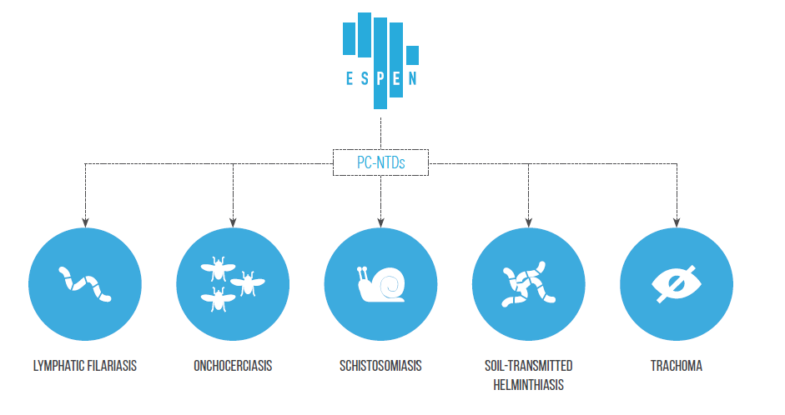


Expanded Special Project for Elimination of NTDs (ESPEN)
Established in the spirit of public-private partnership between WHO Regional Office for Africa, Member States and NTD partners

Slide 3



4 ESPEN OBJECTIVES
1.SCALING UP MDA:
Reach 100% Geographical coverage in Africa
2.SCALING DOWN:
Eliminate and validate
3.STRENG-THENING INFORMATION SYSTEM
for evidence-based decision making
4.IMPROVING THE EFFECTIVE USE OF DONATE MEDICINES
through enhanced supply chain management

Slide 4
Reported number of people treated (million)
PC Implementation 2018 | AFRO
 | SAC/Adults
Number of countries requiring PC | 41
Number of people requiring PC | 109.3M/94.6M
Proportion of District achieving effective coverage in SAC | 89/46.1
Number of People treated (Countries 25 SAC /14 Adults) | 67.5 /14.4

Slide 5
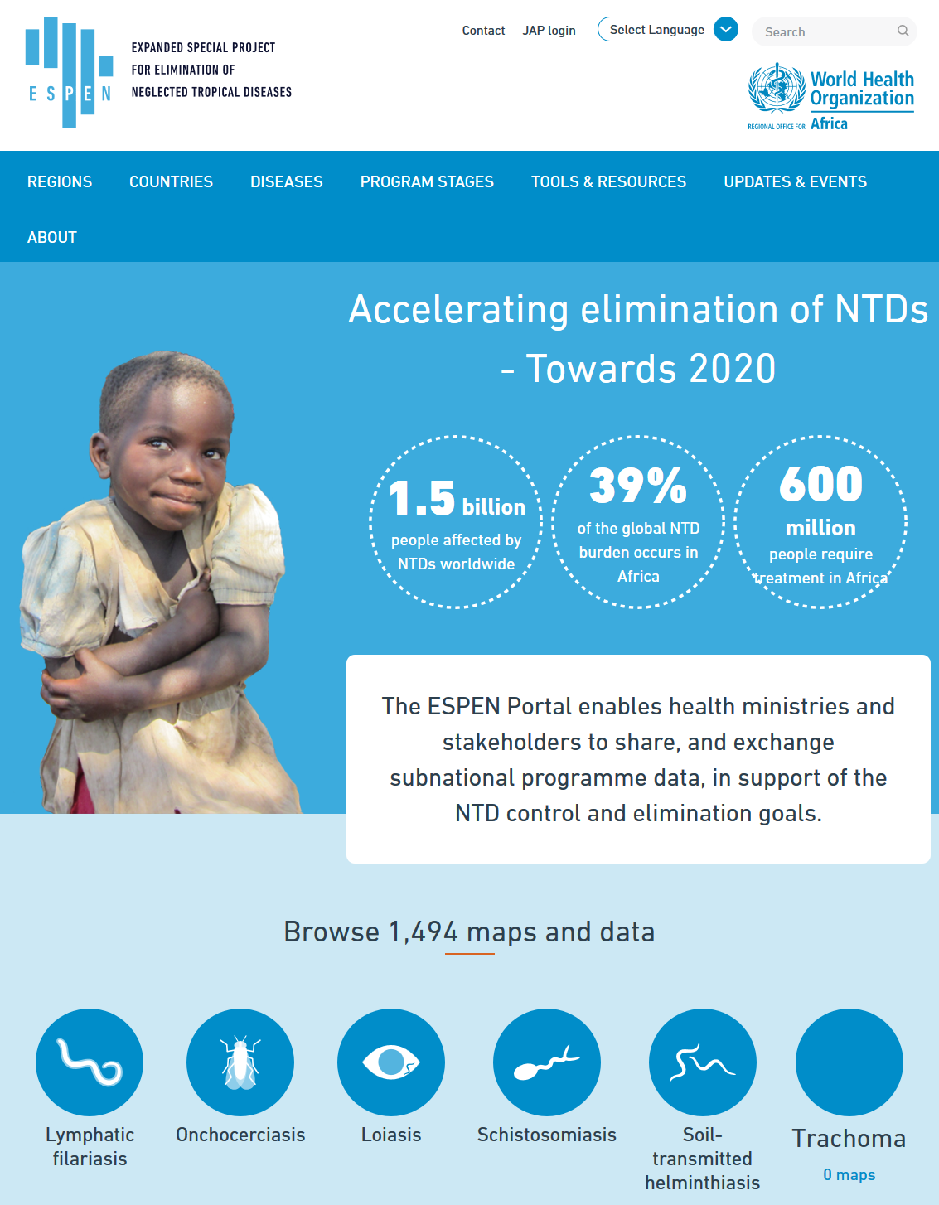
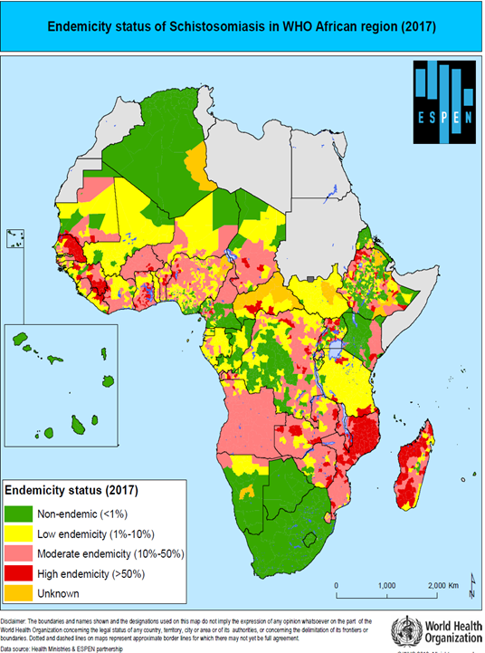
ESPEN PORTAL:
Data-driven approach to plan, implement and monitor towards elimination
Strengthening information systems
ESPEN Portal
http:// espen.afro.who.int
45 African Countries consented to share data
Over 1400 maps and data sets available

Slide 6
SCH Summary Geographical coverage status
MDA not started
MDA started but not at scale or irregular
MDA scaled to all endemic IUs
Need re-assessment of the situation
Equatorial Guinea,
Botswana,
South Africa
Angola, Congo, Nigeria, Somalia, Central African Republic, Chad, Gabon, Guinea-Bissau, Sao Tome and Principe, South Sudan, Zambia, Namibia.
Benin, Burkina Faso, Burundi, Cameroon, Côte d'Ivoire, Democratic Republic of the Congo, Eritrea, Ethiopia, Gambia, Ghana, Guinea, Kenya, Liberia, Madagascar, Malawi, Mali, Mauritania, Mozambique, Niger, Rwanda, Senegal, Sierra Leone, Sudan, Swaziland, Togo, United Republic of Tanzania, Uganda, Zimbabwe
Algeria
Mauritius
Need validation of elimination as PHP
2019 Focus countries for 100% GC
3
12
28
2

Slide 7
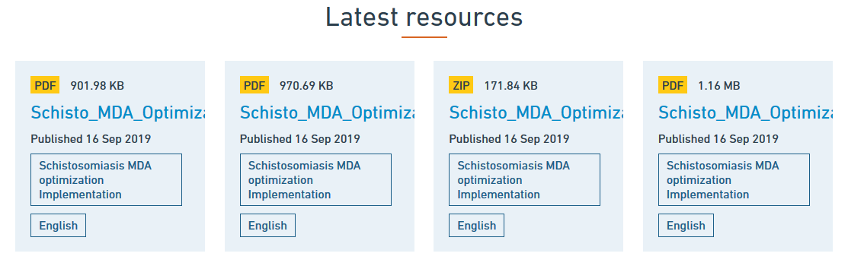
Key Ongoing activities in schistosomiasis:
Expanding the roster of experts
Optimizing use of available tools and data
Sub-district data analysis for more focalized and optimized implementation of interventions
http:// espen.afro.who.int

Slide 8
SCH : Countries that are conducting or ready for impact assessments
 | Countries that have conducted ≥ 5 rounds
 | Benin, Burkina Faso, Burundi, Cameroon, Côte d'Ivoire, Democratic Republic of the Congo, Eritrea, Ethiopia, Gambia, Ghana, Guinea, Kenya, Liberia, Madagascar, Malawi, Mali, Mauritania, Mozambique, Niger, Rwanda, Senegal, Sierra Leone, Sudan, Swaziland, Togo, United Republic of Tanzania, Uganda, Zimbabwe
Implementation status | # Countries
Not yet started MDA | 3
MDA just starting MDA <100% geographical coverage | 12
Mature programmes; MDA at 100% geographical coverage | 28
Protocols development ongoing

Slide 9
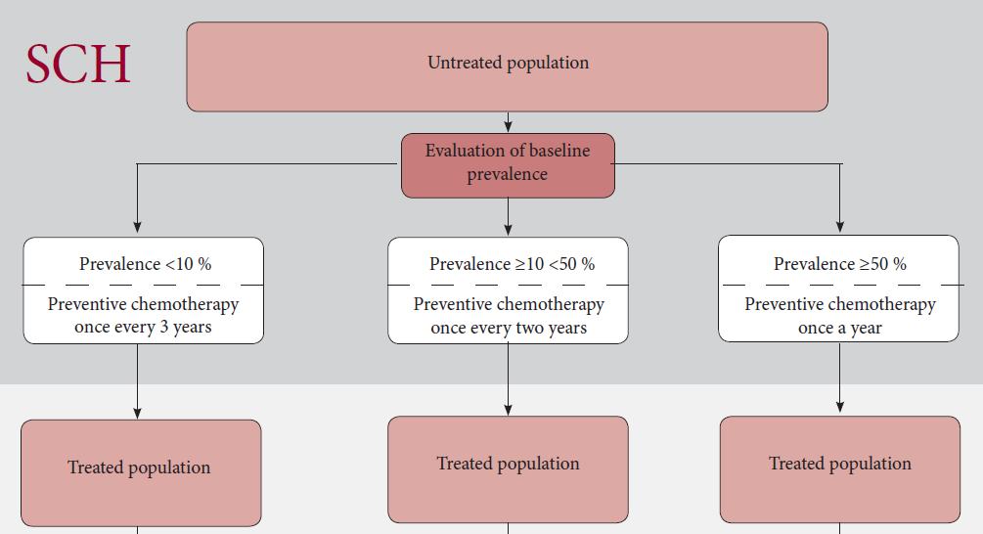
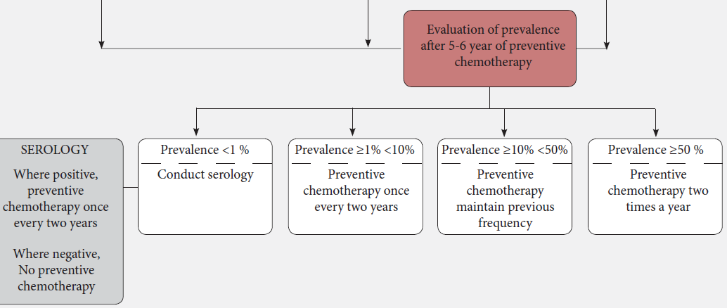

More PZQ and increased investments needed for maturing SCH programmes after impact assessments
.
~ 25 Countries in the African Region have achieved the ≥5-6 year MDA Rounds and are either already conducting or due to conduct impact assessments;
Decisions based on the impact assessments may require intensified PZQ use, which is not considered in the current donation
Treatment coverage ?
Treat all target groups?
11

Slide 10

SCH Control: Areas that are lagging behind
Investing in quality of MDA for high coverage
Impact assessments, including morbidity monitoring
Shrinking the Map
Treatment of adults
Investing in the PHASE* package including snail control
National ownership and domestic financing
* PHASE: PC, Health Education, Access to safe water, Sanitation, Environmental management

Slide 11
ESPEN Towards 2030
Objectives
Draft Priorities
Technical assistance to national governments towards NTD targets
Capacity building of national and regional experts
Encourage a harmonized approach in delivery of technical support
Identify funding opportunities for scale up of interventions
Scaling up MDA to 100% geographical coverage and WHO treatment coverage thresholds
Scaling down activities where targets are achieved
Strengthening information systems
Enhanced supply chain management
Country ownership and health systems strengthening

